Slide 1
CoachX
Evaluation of Style Advisor Performance
Comprehensive Analysis & Insights
Vaibhavi Hambire
Batch: CX-143-MOR-JULY

Slide 2
Introduction & Objectives
Introduction
This project evaluates the performance of Style Advisors based on multiple criteria such as store ambiance, first impressions, discovery of needs, trial experience, and overall customer service.
Objectives
Grade Style Advisors based on evaluation scores.
Analyze performance across different zones.
Identify regions with the highest share of high performers.
Visualize performance trends and criteria scores.
Provide insights and actionable recommendations.

Slide 3
Data Overview
Dataset size: 61 evaluations × 82 columns.
Key Columns:
Evaluation_ID, Evaluation_Date, Evaluation_Score
Defines Locations: Zone, City, State, Country
Criteria like Store Ambiance, First Impressions, Discovery, Trial Experience, Objection Handling, Closure & Care.
Demographics of auditors (Age, Gender).

Slide 4

Performance Grading
Grading Scale:
If Evaluation Score is in between below this value mention Grades are Assign:
Performance Grades by Zone
High Performer: 90–100
Average Performer: 70–89
Low Performer: 50–69
Bottom Performer: <50
Example: Count of Each Grade by Zone
Low Performer High Performer Bottom Performer Average Performer
East
North
South West
Example Fig.

Slide 5

Pivot Table Analysis
Zone Analysis by Score
Average Score of Evaluation score by each Zone
North has Highest Average Evaluation Score – 76%
South has Lowest Average Evaluation Score – 66%
Performance variation suggests
different quality across regions
East
North
South
West

Slide 6
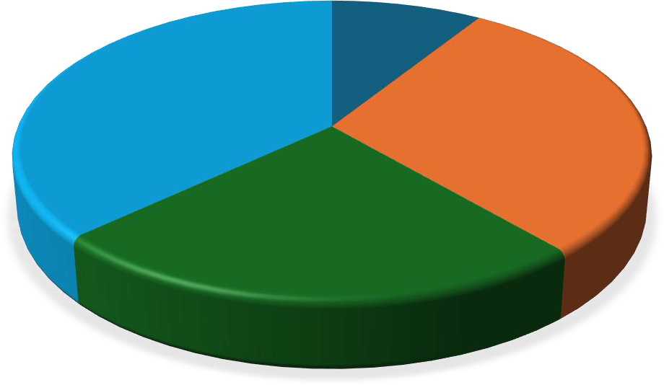
Pivot Table Analysis
High Performer Analysis
West has Highest % of High Performers – 37%
East has Lowest % of High Performers – only 9%
HIGH PERFORMERS BY ZONE
East
9%
West 37%
North 30%
Indicates certain zones consistently deliver better customer service except East
South 24%

Slide 7
Pivot Table Analysis
3. Trend Over Time
Trend Over Time By Evaluation Score
Daily trend (October 2022) shows fluctuations.
Toward Oct 27–29, performance
drops again.
Score is drop very fast needs improvement in styling.

Slide 8
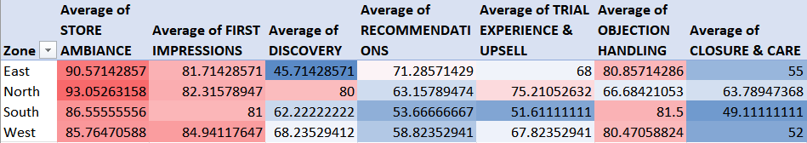
Pivot Table Analysis
4. Heatmap: Criteria Scores by Zone
Ambiance and First Impressions is strong in all regions.
Recommendations and Closure & Care is weak in all regions.
In East, Discovery is most weak among all criteria and zone.
Highlights where Trail Experience & Upsell should be targeted and also Discovery.

Slide 9

Pivot Table Analysis
5. Performance Grade Distribution
North Zone, indicating the
strongest overall. performance.
Performance Grades by Zone
South and West Zones show a
balanced mix.
East Zone suggesting individuals or lower
fewer overall
Low Performer High Performer Bottom Performer Average Performer
performance.
Prioritize
performance
improvement initiatives in the East
zone, where low and performers dominate
bottom
the
East
North
South
West
distribution.

Slide 10
Key Insights
Regional Variation
North Zone: Highest overall average score (76%).
South Zone: Lowest average score (66%).
East Zone: Weakest performance with lowest share of high performers (9%).
West Zone: Strongest zone with 37% high performers.
Criteria Performance
Strength: Ambiance & First Impressions.
Weakness: Discovery, Closure & Care, Recommendations.
East Zone Discovery is the weakest across all criteria.
Performance Trends
Fluctuations observed in October 2022.
Significant drop in performance during Oct 27–29.

Slide 11
Recommendations
Improve Weak Criteria
Focus on Discovery, Closure & Care, and Upselling techniques across all zones.
Targeted Training
Intensive coaching in East Zone due to high share of low/bottom performers.
Best-practices sharing from West Zone to other zones.

Slide 12
Conclusions
Style Advisors show inconsistent performance across zones.
North and West perform strongly, while East requires urgent attention.
Strength lies in Ambiance & First Impressions, but Discovery & Closure remain challenges.
With targeted training, mentoring, and continuous monitoring, overall customer service quality can improve, leading to better customer satisfaction and higher business impact.

